Slide 1
Analyzing and Predicting California's Unemployment Rate Using Deep Learning
Group 10
Jayesh Yevale (jyeval2)
Ethan Torres (ethanjt2)
Joshua Kendrick (joshua39)
Dhruv Oza (dhruvo2)

Slide 2

California’s Unemployment
Introduction
California, with its diverse economy and large population, faces ongoing challenges related to unemployment.
The State of California still faces and struggles with economic instability, high inflation, and poverty rates.
We need of reliable tools for government, policymakers and individuals to understand and anticipate changes in the job market scenarios for making appropriate and informed decisions.
Predicting unemployment trends is a critical necessity especially after the COVID-19 pandemic.
Jayesh

Slide 3

Overview of the Project
Introduction
Our project aims to develop a model using deep learning to predict California’s unemployment rate.
We will provide detailed insights on how employment trends may evolve in the near future.
The steps we followed were:
Data Extraction & Exploration
Data Modeling & Baseline Model
Implementation & Tuning Parameters
Prediction
Feature Importance
Jayesh, Dhruv

Slide 4
Overview
Data Extraction
Data Exploration
Implementation
Feature Importance
Conclusion

Slide 5

Data Extraction
Jayesh

Slide 6

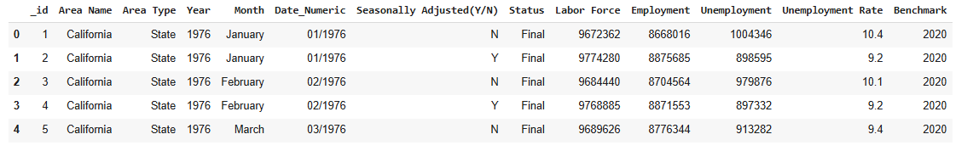
Data Preparation
Data Extraction
Data source: Local Area Unemployment Statistics for California dataset.
Data Description: Jan. 1976 - Aug. 2024.
Total Entries: 203,072 employability data across various areas.
Features: Month, Year, Area, Total Labor Force, Employment, Unemployment, Area Type
Labels: Unemployment Rate. Train: Test Split = 80:20
Jayesh

Slide 7

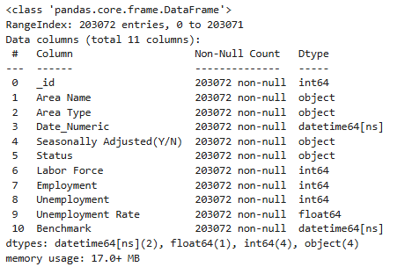
Data Preparation
Data Extraction
We cleaned the data by removing
missing values, duplicate values, etc.
We updated the columns with
appropriate formatting.
Also, we pickled the dataset for
easier computation.
Jayesh

Slide 8
Data Exploration
Joshua

Slide 9
Data Exploration
Data Exploration
We found multiple statistics for each feature
count, mean, min, quartiles, max, and standard deviation
Then we visualized our data through multiple graphs
Histograms
Pie Charts
Bar Charts
Correlation Matrix
In doing such, we are able to see trends and patterns that may affect our models
Joshua

Slide 10
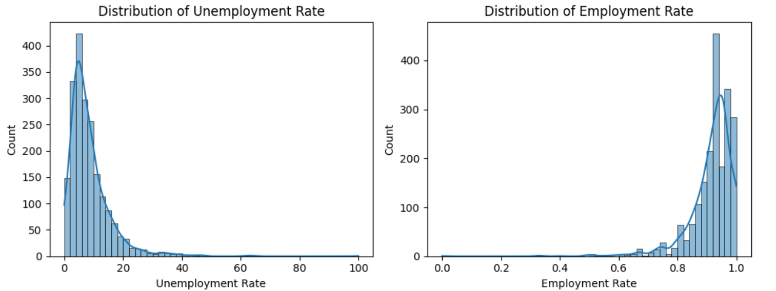
Histograms
Here, we see that unemployment and employment are highly skewed distributions
Thus, we should expect that unemployment rates are concentrated at the lower end of values
Joshua

Slide 11
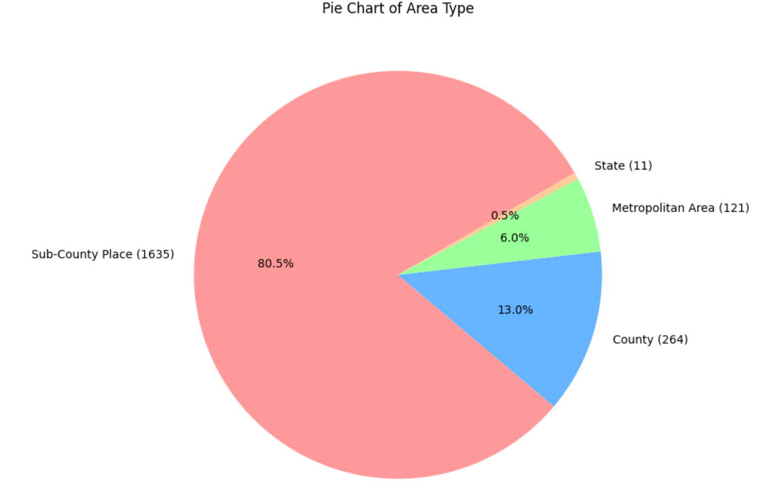
Pie Chart
Here, we see that unemployment counts are concentrated in sub-county places
Thus, we should expect any model to over-represent those type of counties
Joshua

Slide 12
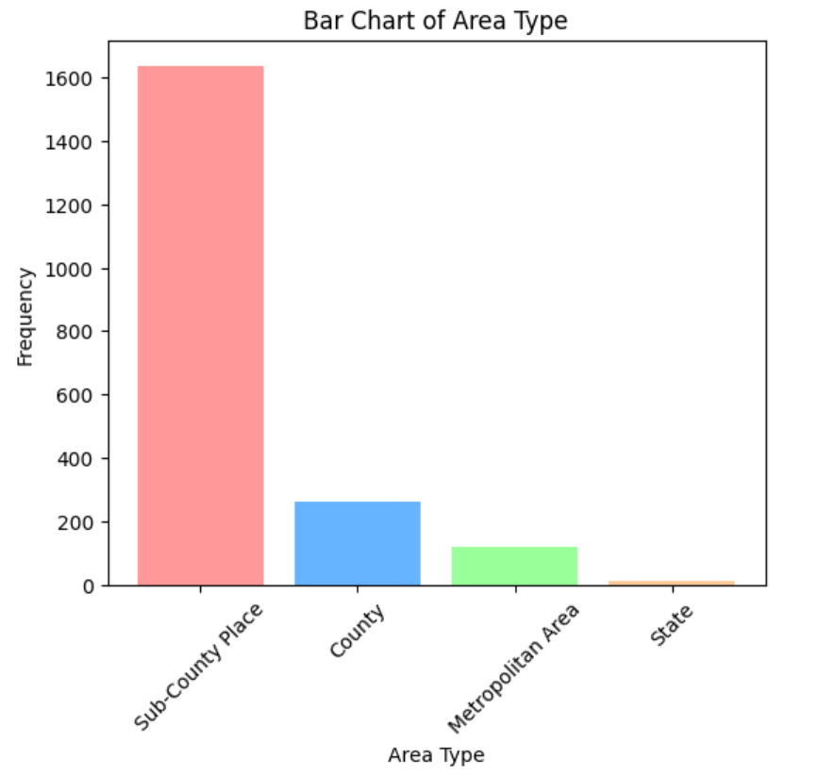
Bar Chart
Here, the bar chart affirms the intuition gathered from the pie chart
Joshua

Slide 13
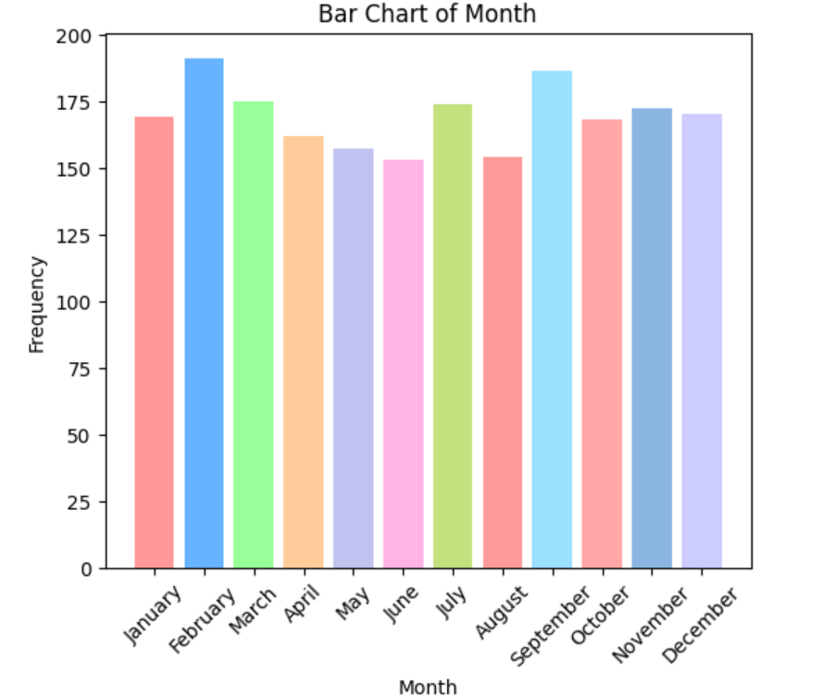
Bar Chart cont.
Here, the values seem to be consistent among the months
Hence, we should not expect months to be a big contributor to our model
Joshua

Slide 14
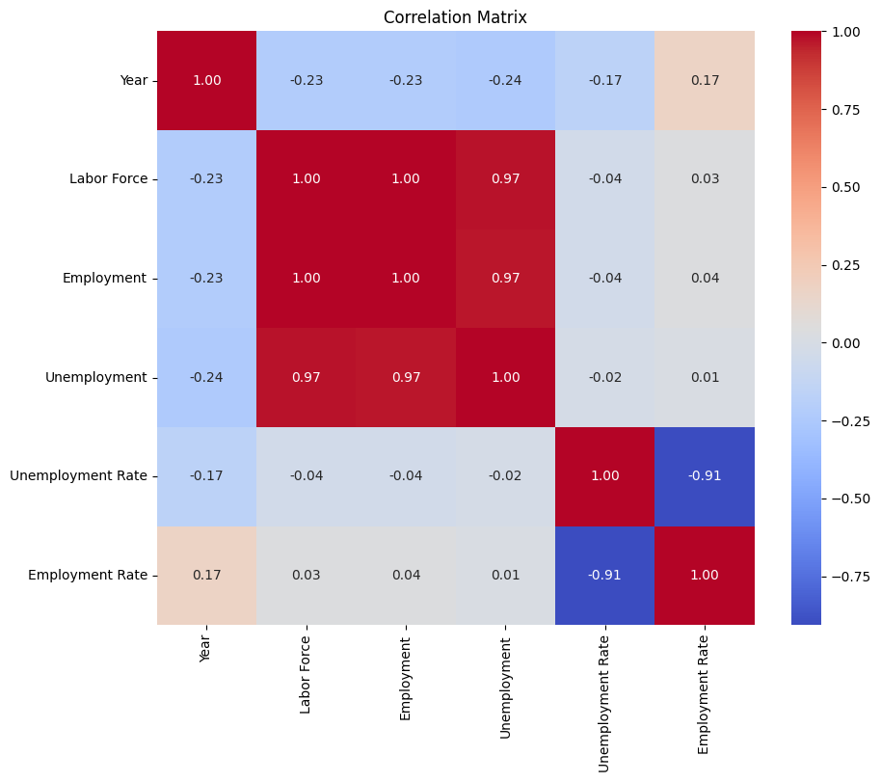
Correlation Matrix
From the correlation matrix, we have terms with strong correlation, so we may expect multicollinearity if left as is
Also, we can look at those terms highly correlated with unemployment rate and expect them to have a large impact in our model for predicting unemployment rate
Joshua

Slide 15
Baseline Model
Data Exploration
For future comparison, we model predictors of unemployment from our dataset using:
Linear regression: MSE of 1.79 and an R-squared value of 0.97
Ridge Regression (with scaling): MSE of 2.11 and an R-squared value of 0.96
Decision Tree Regressor: MSE of 4.89 and an R-squared value of 0.91
Joshua

Slide 16
Implementation
Ethan

Slide 17
Model Selection
Implementation
-The process presented is self-exciting, so we need something that captures historical data when making predictions
-RNNs excel at capturing sequential data, which is why they work well for time-series data
-RNNs also have memory and retain information from previous steps
-They are extremely flexible for understanding complex patterns and long-term dependencies
-As a result, RNNs can learn from these complex patterns from the historical data and make more dynamic and reliable predictions
-Utilizing different optimizers as well can greatly improve the prediction quality given the data’s dynamic nature
Ethan

Slide 18
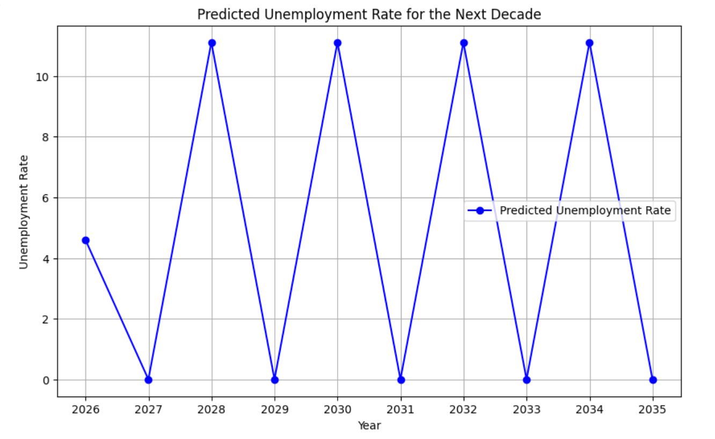
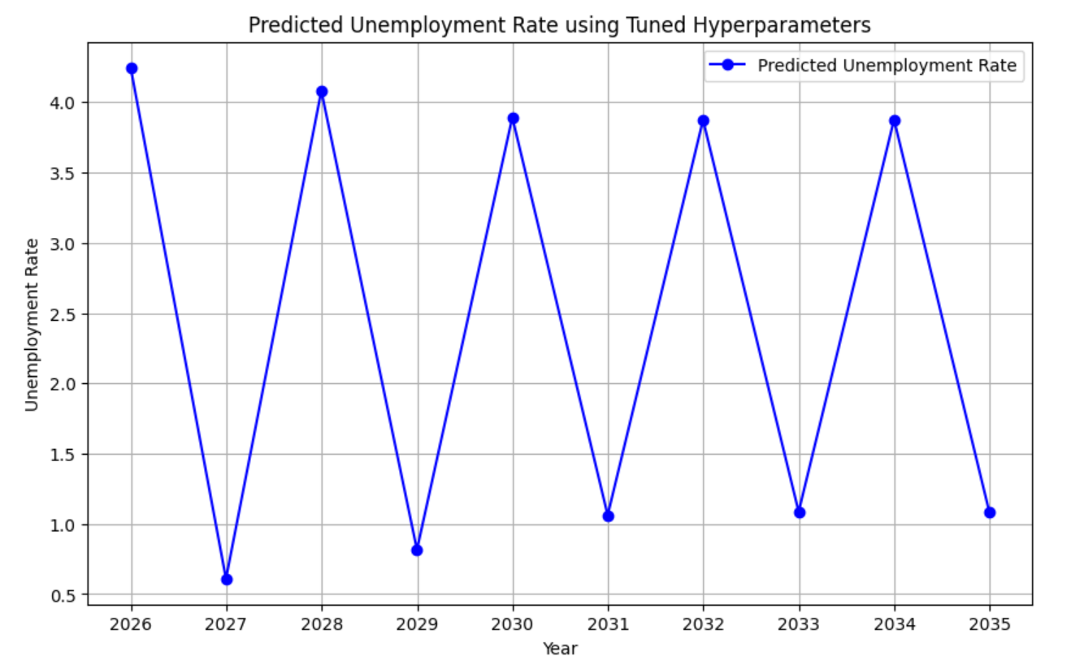
Hyperparameter Tuning
Implementation
-We utilized Optuna, a framework for hyperparameter optimization to efficiently search through the hyperparameters for 30 trials
-We optimized three relevant parameters: hidden_size, dropout_rate, and learning_rate
-After optimizing, we can then retrain the RNN using parameters that will greatly improve the predictions of the network
Ethan

Slide 19
Final Model and Predictions
Implementation
- As can clearly be seen, there is an oscillation in the prediction with a slight conversion in each direction year over year (this same trend appears in both SGD and Adam)
- This can stem from multiple factors: economic cycles, model fine-tuning, relevant feature exploration, and smooth predictions (regularization, lagged variables, etc…)
Ethan

Slide 20
Feature Selection
Dhruv

Slide 21
Methods Used and Implementation
Feature Selection
Feature Selection Techniques:
Permutation Importance Analysis
SHAP value analysis
Implementation Steps:
Started with 13 initial features
Used RNN model with Adam optimizer (best model from model selection)
Applied feature permutation to assess importance
Calculated MSE increase for each permuted feature
Generated SHAP values for detailed feature impact analysis
Technical Approach:
Baseline performance established with complete feature set
Individual features randomly permuted to measure impact
Features ranked by their effect on model performance
SHAP analysis for feature contribution visualization
Dhruv

Slide 22
Results
Contributor(s)- Dhruv Oza
Feature Selection
1. Top Influential Features (by MSE Impact):
Year (210.27) - Most significant temporal impact
Date_Numeric (114.86)
Employment Rate (89.49)
Unemployment (26.56)
2. Non-Influential Features (0.00 MSE Impact):
Area Name, Area Type, Month, Seasonally Adjusted(Y/N), Status
Key Findings:
Temporal features dominate prediction accuracy
Employment-related metrics show strong predictive power
Geographic features have minimal impact
Model shows strong dependency on historical patterns
Dhruv

Slide 23
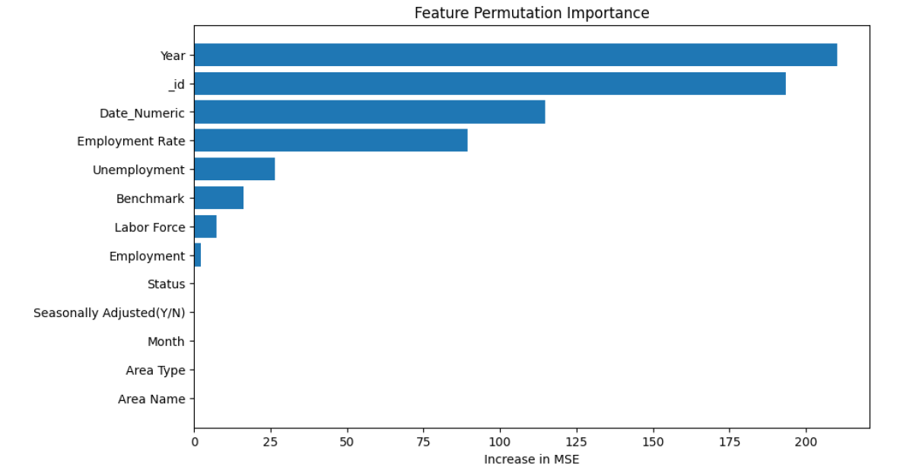
Plots
Contributor(s)- Dhruv Oza
Feature Selection
Features ranked by the increase in MSE
Dhruv

Slide 24
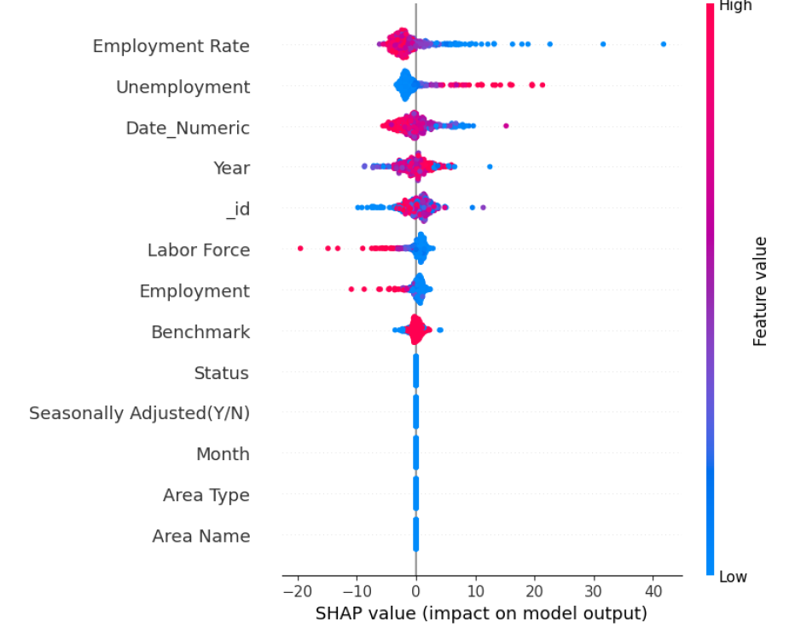
Plots
Contributor(s)- Dhruv Oza
Feature Selection
Features ranked by Shapley Values
Dhruv

Slide 25
Conclusion
Everyone

Slide 26
Summary
Conclusion
This project successfully developed a deep learning model (RNN) to predict California's unemployment rate.
The approach included comprehensive data preprocessing, exploration, model selection, and feature analysis.
Key insights reveal that temporal and employment-related metrics are critical predictors.
Dhruv

Slide 27
Concluding Thoughts
Conclusion
Expand Data Sources: Incorporate additional economic and social indicators (e.g., GDP, inflation, job vacancy rates) to improve prediction accuracy.
Explore Alternative Models: Test transformer-based models or hybrid architectures for improved sequence modeling.
Refine Deployment: Develop a pipeline for real-time predictions and continuous updates to adapt to changing economic conditions.
Stakeholder Collaboration: Work closely with policymakers and businesses to align predictions with actionable strategies.
Dhruv

